Slide 1



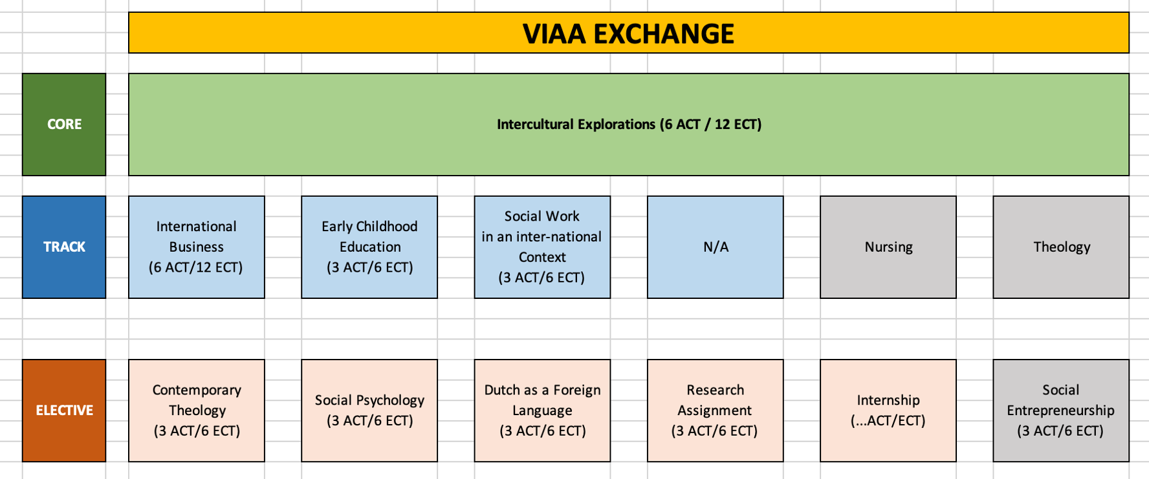
February 2024-June 2024
Who …
What
News
Contact

